Slide 1

Project4:
Vulnerability Assessment and Remediation plan
By:
Osama Montaser
Instructor:
Eng. Mohamed Ammar

Slide 2
DISCLAIMER !!!
This project was conducted in a controlled environment with permission.
The names and events mentioned are fictional and have no connection to reality, and any resemblance to reality is stranger than fiction.

Slide 3

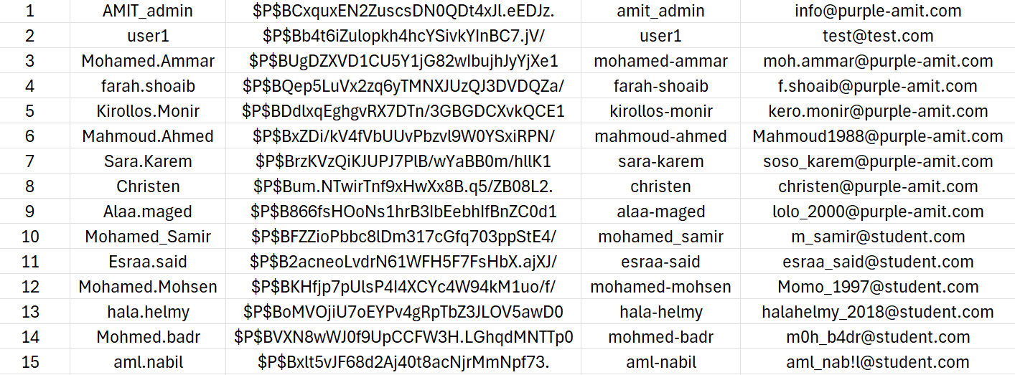
Scenario:
Purple Amit, a leading tech company, recently experienced a data breach. Sensitive customer and employee data were compromised, raising concerns about their overall security posture.
In response, the company’s CISO, Eng. Omar El-Sayed, hired me to conduct a comprehensive vulnerability assessment, perform penetration testing, and develop a remediation plan to address the security gaps.

Slide 4
Scenario:
Challenges Faced:
The breach resulted in reputational damage and loss of customer trust. The goal is to restore confidence by identifying vulnerabilities and implementing secure configurations and patch management.
Purpose of the Project:
The project involves assessing vulnerabilities, testing security weaknesses, and implementing remediation to prevent future breaches and improve Purple Amit’s overall cybersecurity.

Slide 5
Table of Contents
Lab Topology
Week 1: Vulnerability Assessment
Week 2: Penetration Testing
Week 3: Secure Configuration and Patch Management
Week 4: Final Report and Presentation
Remediation Summary and Recommendations
Conclusion

Slide 6
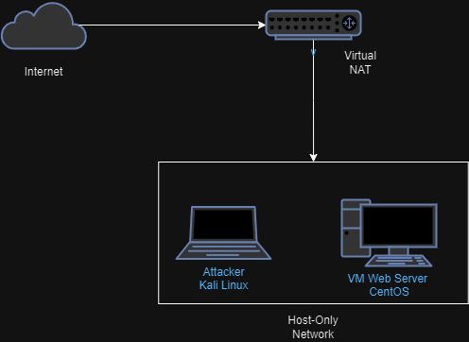
Lab Topology

Slide 7

Website Review
From the attacker PoV

Slide 8

Before Vulnerability
assessment
Take a first insight of Wapplyzer Google Chrome
Extension to identify the technologies used
on the website
WP scan can be used since the website using WordPerss

Slide 9

Week 1: Vulnerability Assessment
1
Objective
Uncover potential security risks in Purple Amit’s company.
2
Scope
Application-based (Website)
Host-based (Web server)
3
Tools
Nmap, WPScan, Nikto, and Nessus were used for the assessment.
4
Findings
Vulnerabilities ranged in severity from critical to low

Slide 10
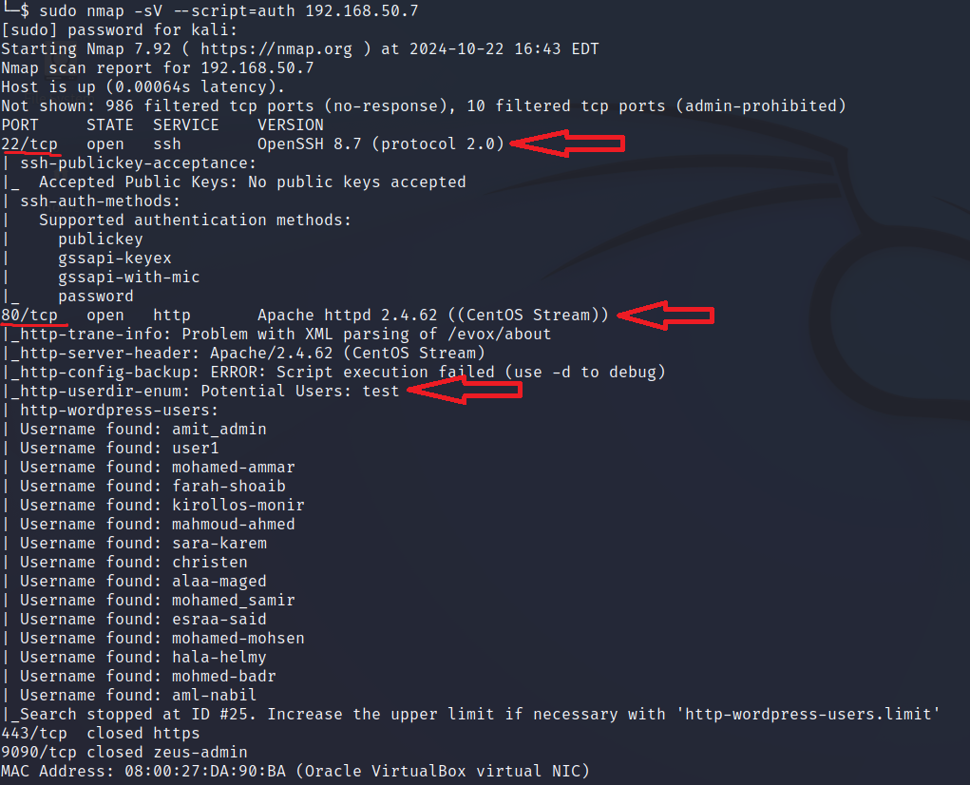
Findings Quick review
nmap

Slide 11
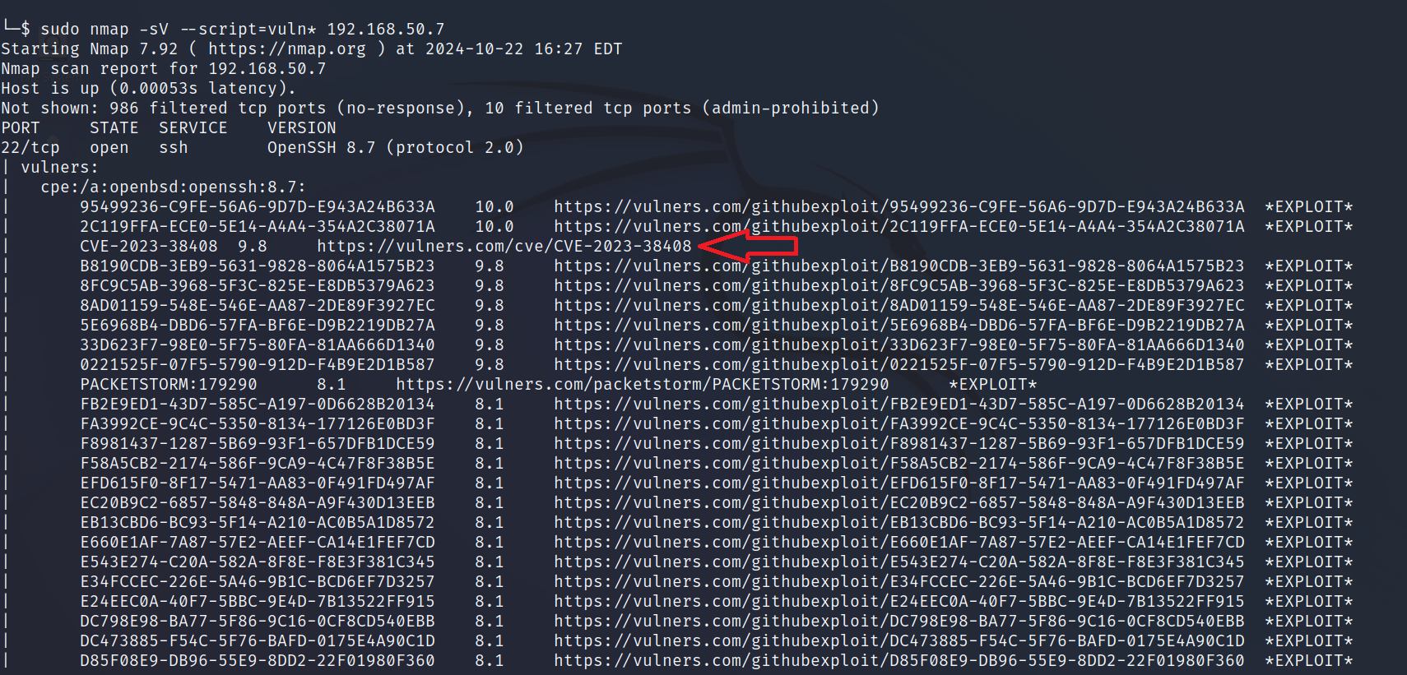
Findings Quick review nmap

Slide 12
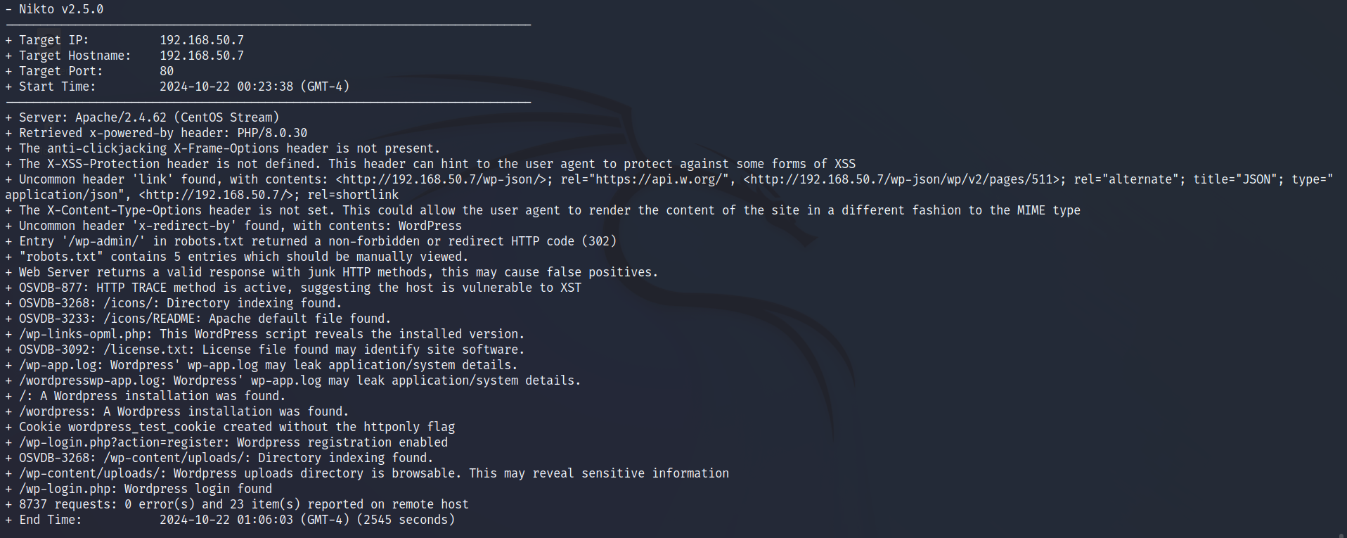
Findings Quick review
nikto

Slide 13
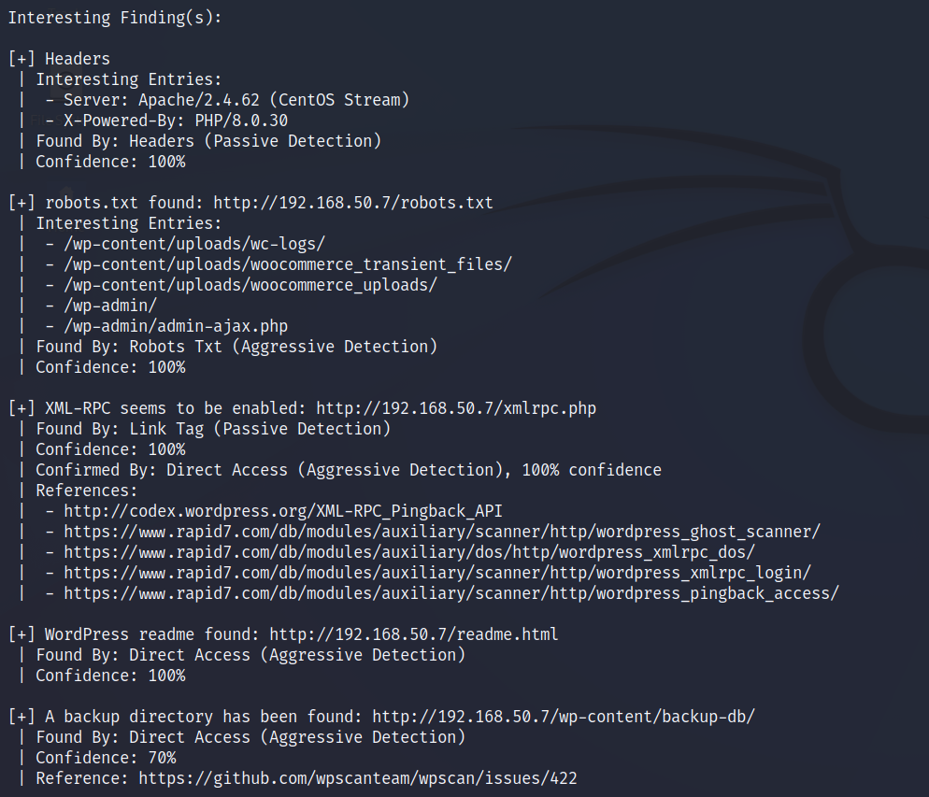
Findings Quick review
WPscan

Slide 14
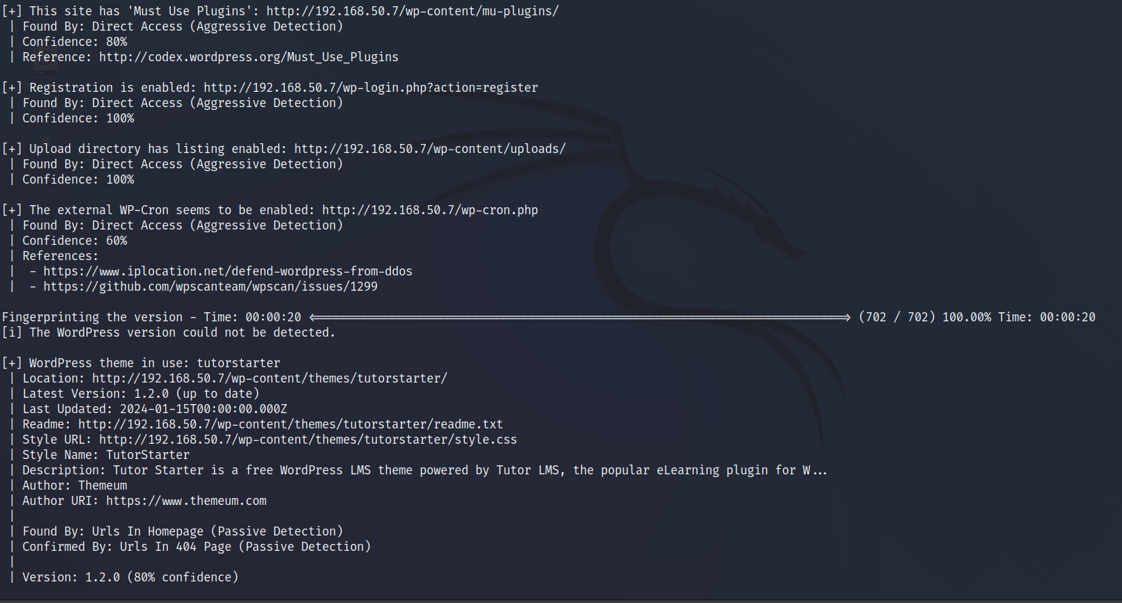
Findings Quick review: WPscan

Slide 15
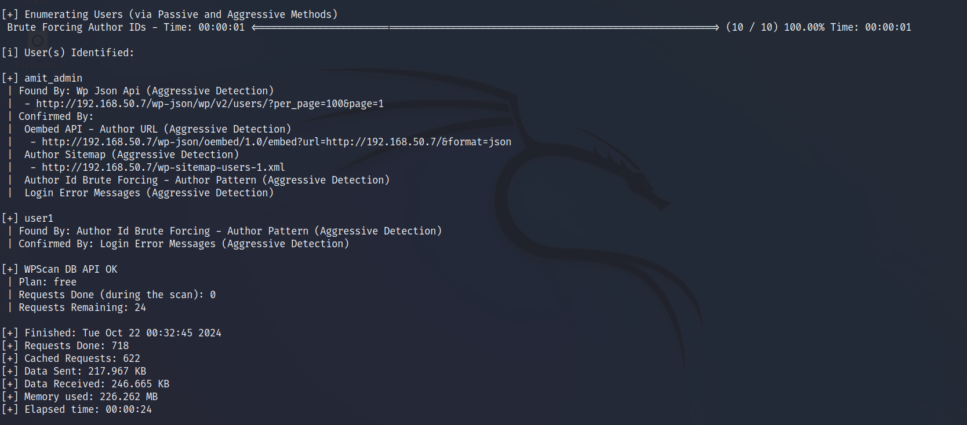
Findings Quick review: WPscan

Slide 16
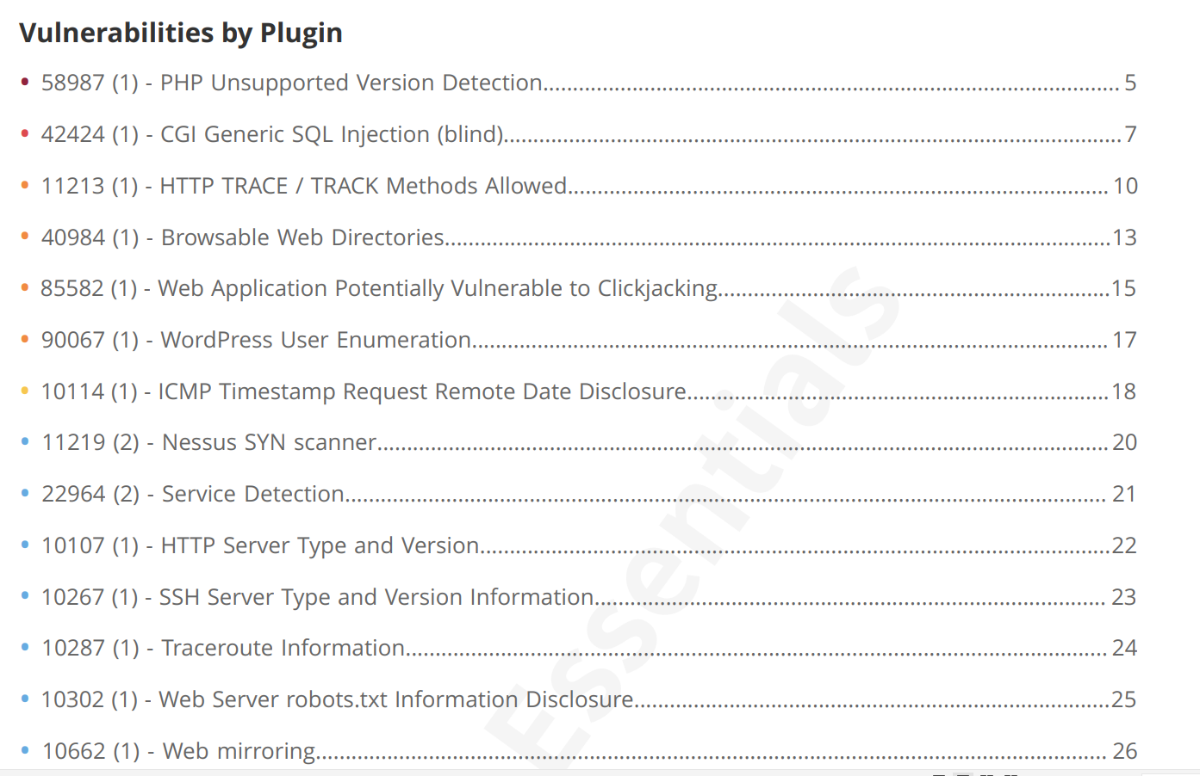
Findings Quick review: Nessus

Slide 17
Preform Risk Assessment on findings
1
Critical (9.0 – 10.0)
OpenSSH (CVE-2023-38408), outdate PHP version
2
High (7.0 – 8.9)
Public backup directories, HTTP TRACE enabled.
3
Medium (4.0 – 6.9)
Missing HTTPS, missing security headers, exposed WordPress admin access.

Slide 18

Week 2: Penetration Testing
1
Objective
Exploit identified vulnerabilities to assess their potential impact and real-world implications.
2
Tools
Metasploit, Burp Suite, and manual techniques were used for exploitation.
3
Results
Successful exploits demonstrated the potential for data breaches and system compromise.

Slide 19
Week 2: Penetration Testing Methodology
1
Method
Exploiting Vulnerabilities from the Vulnerability Assessment Report

Slide 20
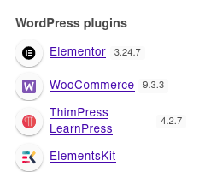
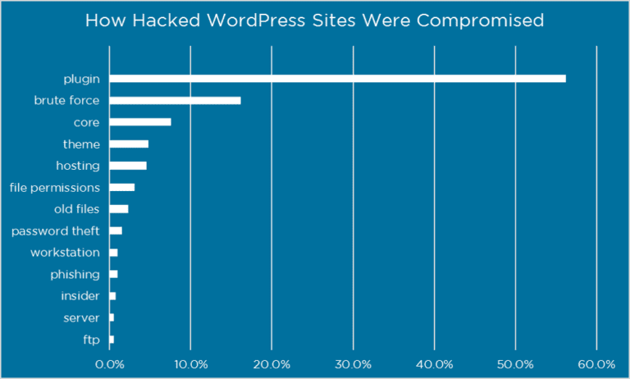
Week 2: Penetration Testing Methodology
Method
2
Plugin Exploitation in WordPress Using Wappalyzer

Slide 21
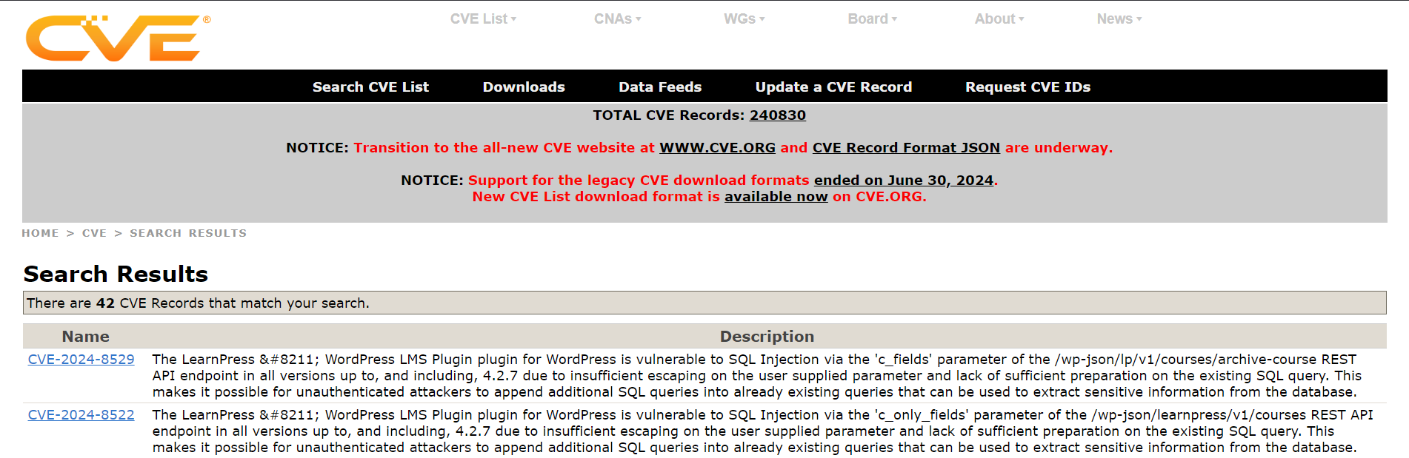
Week 2: Penetration Testing Methodology
2 Vulnerabilities none of vulnerability scanning tools detect it !!

Slide 22
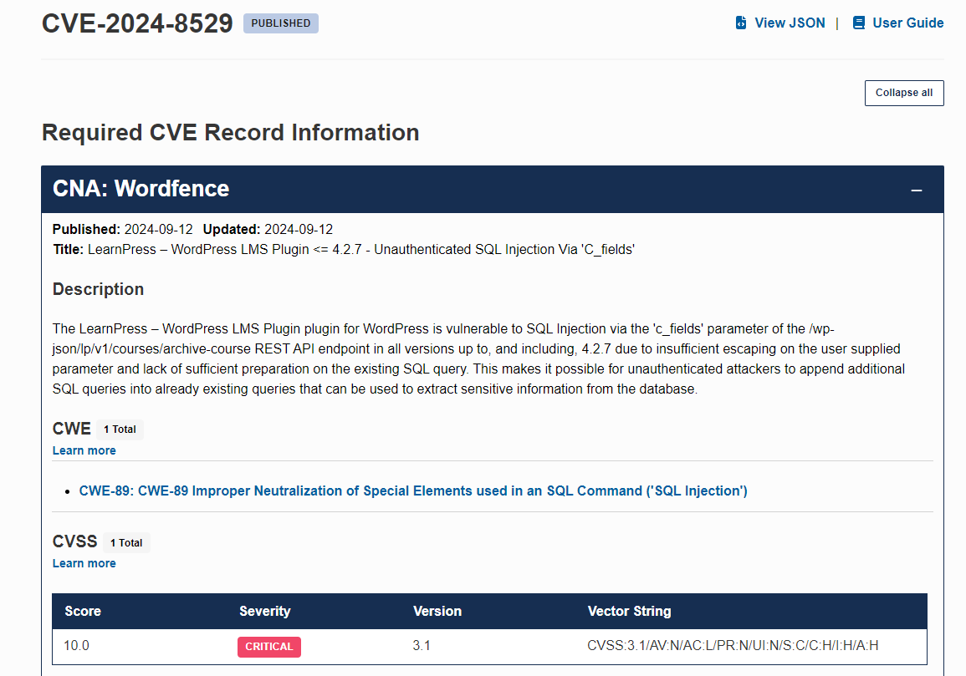
CVE-2024-8529
Score: 10 !!
Critical
Most probably the attacker use one of these vulnerability

Slide 23
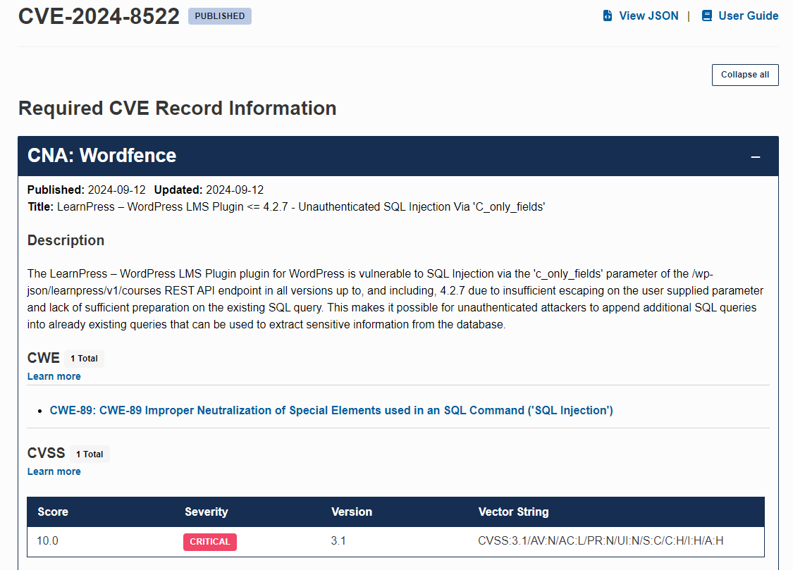
CVE-2024-8522
Score: 10 !!
Critical
Most probably the attacker use one of these vulnerability

Slide 24
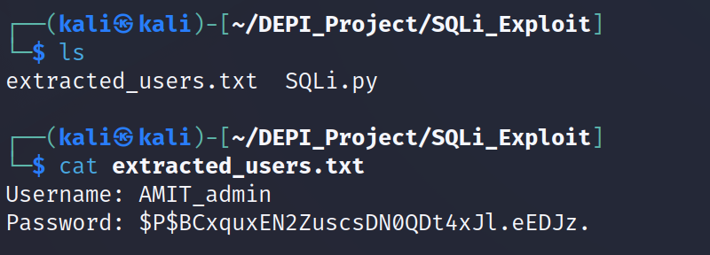
The exploitation of the CVE-2024-8522
I made a custom private exploitation code to extract the database information

Slide 25
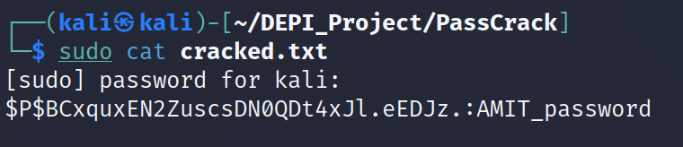
The final step is cracking the hash password to gain access
Using hashcat to crack the password

Slide 26
Still the threat actor exist on the server ?!
You can’t decide in this case because the WordPress lacking the activity logs

Slide 27
Week 3: Secure Configuration and Patch Management
Secure Configuration
Patch Management
Web server and WordPress hardening were implemented, including disabling unnecessary services, restricting access, and enforcing strong passwords.
A structured patching system was established to ensure regular software updates and address new vulnerabilities.

Slide 28

Week 4: Final Report and Presentation
Final Report
Summarized identified risks, successful exploits, and actions taken to mitigate future risks.
Remediation Plan
Outlined immediate patching of critical vulnerabilities and long-term improvements like continuous vulnerability scanning and secure configurations.

Slide 29



Remediation Summary and Recommendations
Immediate Actions
Patching critical vulnerabilities in OpenSSH and WordPress plugins, securing directories, and enforcing secure configurations.
Ongoing Recommendations
Implementing an IPS/IDS, using a SIEM solution, and regularly reviewing security policies.

Slide 30

Conclusion
Regular vulnerability assessments and secure configuration management are crucial for preventing breaches. Purple Amit's security posture significantly improved, and ongoing monitoring will help avoid future incidents.

Slide 31
Thank You
Any Questions ?

